Slide 1
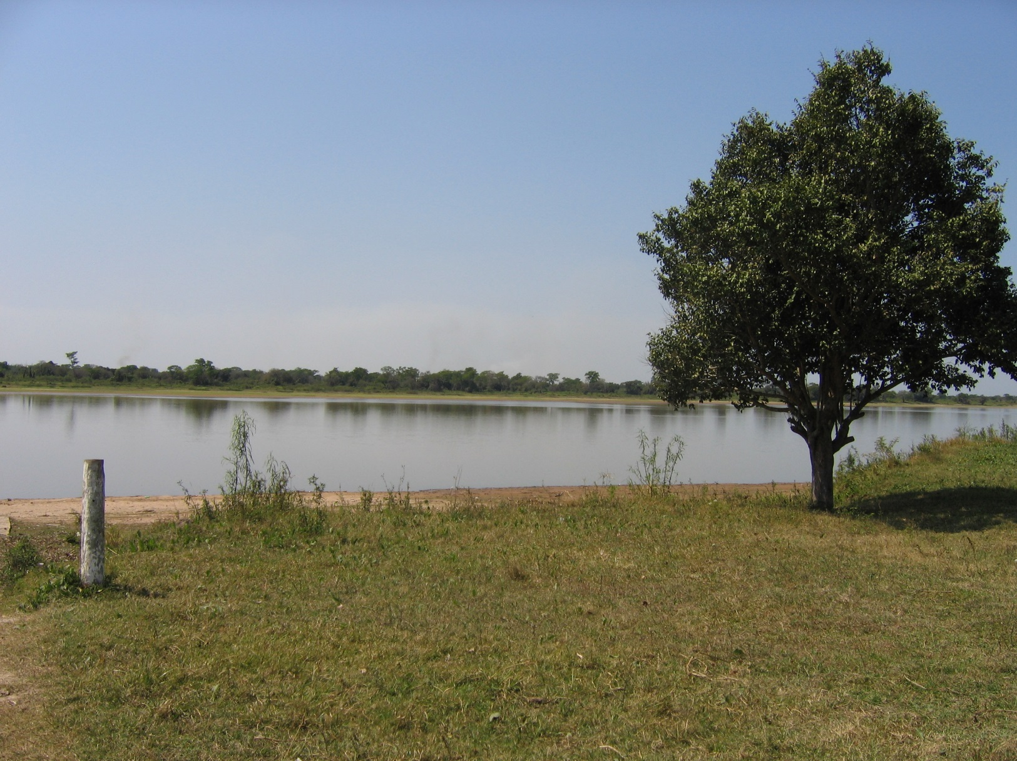
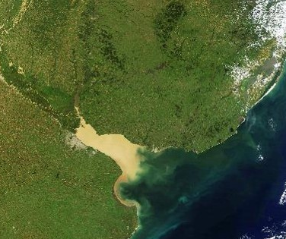

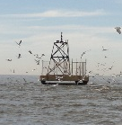
Vegetal detritus
─S34
Buenos Aires City
W58
I
Anthropogenic detritus

Slide 2





μg/g
μg/g
Sterol content
X 170
Settling material
Accumulation efficiency
2-6%
X 2-7
5-40%
Sediments
2-6%
3%
2%
2-6%
7-40%
10-14%
5%
6-10%
Anthropogenic detritus

Slide 3
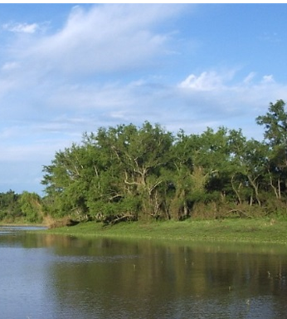
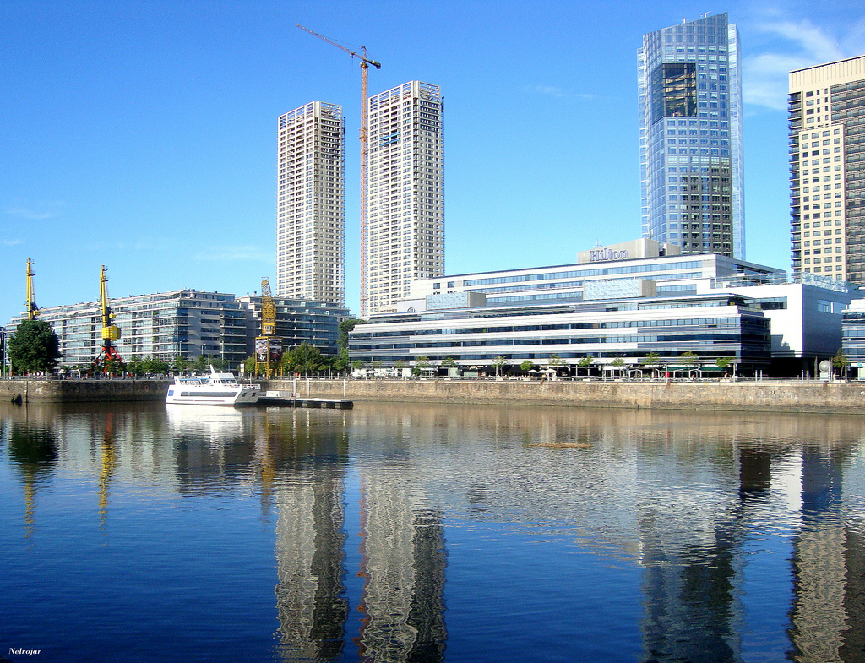
Uruguay River
Land plant input
Buenos Aires city
Sewage input
μg/g
μg/g
Sterol content
X 170
Settling material
Accumulation efficiency
2-6%
5-40%
X 2-7
Sediments
Oxic
Anoxic
Anthropogenic detritus

Slide 4




Uruguay River
Land plant input
Buenos Aires city
Sewage input
μg/g
μg/g
Sterol content
X 170
Settling material
Accumulation efficiencies (%)
2-6
3
2
2-6
7-40
10-14
5
6-10
Sediments
Oxic
Anoxic
Anthropogenic detritus

